Slide 1

Developer vs. Best Developer
An approach to best coding practice
Santosh Kumar Kar

Slide 2
A Developer
Aka mediocre developer
They are Good at their job
Produce functional code
May not prioritize on
code readability,
maintainability,
adherence to best practices

Slide 3
Best Developer additionally focuses on:
CLEAN CODE
Elevating Code Quality
1
Improving Readability and Maintainability
2
Reducing Technical Debt
3
Enhancing Collaboration and Productivity
4

Slide 4
Significance of clean code
Readability and Understandability
Maintainability and Extensibility
Debugging and Troubleshooting
Reduced Technical Debt

Slide 5

Task – 1:
https://github.com/santoshkar/CleanCodeDemo/blob/main/src/main/java/com/cleancode/demo/DispatchInformation.java
Time 5-10 minutes
From the above code:
Identify the purpose of this code
If you are a code reviewer, what improvements can you do?

Slide 6
Challenges in code (Quality issues)
Modularity and Separation of Concerns
Error Handling
Comments and Documentation
Input Validation
Null Checks
Exception Handling
Logging
Variable Naming
Code Formatting and Style
Testing

Slide 7
Bad Code vs Clean Code
Bad Code
https://github.com/santoshkar/CleanCodeDemo/blob/main/src/main/java/com/cleancode/demo/DispatchInformation.java
Clean Code
https://github.com/santoshkar/CleanCodeDemo/blob/cleancode/src/main/java/com/cleancode/demo/DispatchInformation.java

Slide 8
The Benefits of Clean Code
Enhanced Readability
Improved Maintainability
Streamlined Collaboration
Reduced Debugging Time
Faster Onboarding for New Developers
Better Code Reviews
Reduced Technical Debt
Higher Quality Software

Slide 9
Guidelines for writing clean code
Meaningful Names
Single Responsibility Principle (SRP)
Don't Repeat Yourself (DRY)
Keep Functions/Methods Small
Avoid Deep Nesting
Comments and Documentation
Formatting and Indentation
Use Descriptive Function/Method Signatures
Avoid Magic Numbers and Strings
Error Handling
Separation of Concerns
Consistent Naming Conventions
Use Version Control
Unit Testing & TDD
Refactor Regularly:
Avoid Complex and Nested Conditionals:
Limit Function/Method Arguments:
Use Design Patterns Wisely:
Optimize for Readability:
Continuous Learning and Improvement:

Slide 10
SOLID Principles
S - Single Responsibility Principle (SRP)
O - Open-Closed Principle (OCP)
L - Liskov Substitution Principle (LSP)
I - Interface Segregation Principle (ISP)
D - Dependency Inversion Principle (DIP):

Slide 11
Single Responsibility Principle (SRP)
A class should have only one reason to change,
It should have only one responsibility or job. (Code Example)
Open-Closed Principle (OCP)
A class should be open for extension but closed for modification
You should be able to add new functionality to a class without altering its existing code. (Code Example)
Liskov Substitution Principle (LSP)
Objects of a superclass should be replaceable with objects of its subclasses without affecting the correctness of the program.
Any code that works with a base class should also work with derived classes without knowing it. (Code Example)
Interface Segregation Principle (ISP):
clients should not be forced to depend on interfaces they do not use.
In other words, it's better to have smaller, more specific interfaces tailored to the needs of the clients, rather than one large interface that includes methods irrelevant to certain clients. (Code Example)
Dependency Inversion Principle (DIP)
High-level modules should not depend on low-level modules. Instead, both should depend on abstractions (interfaces or abstract classes).
Additionally, abstractions should not depend on details; details should depend on abstractions. (Code Example)

Slide 12
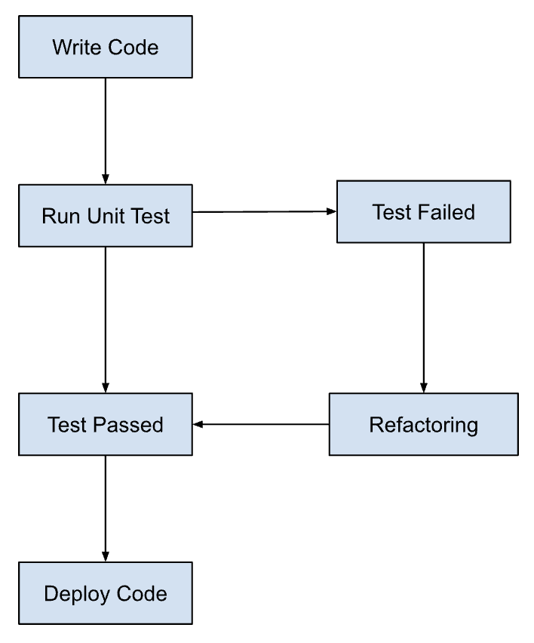
Testing and TDD
TDD Vs. Traditional Testing
Red-Green-Refactor Cycle
Three Phases of Test Driven Development

Slide 13

Design Patterns

Slide 14

Key Takeaways
Focus of Best Developer
Significance of clean code
Bad Code and Good Code Example
SOLID Principles
TDD

Slide 15

Q&A

